Slide 1
HR Analytics - Predicting Employee Attrition

Slide 2
Executive Summary (1/2)
📝 Summary of HR Attrition Analysis
High employee attrition can significantly affect an organization's performance, leading to:
Increased recruitment and training costs
Loss of expertise, productivity disruption, and customer relationship issues
Delays in project delivery and decreased team morale
To proactively address this, a predictive analytics approach was adopted. Using employee data, a Random Forest model was developed to predict attrition with high accuracy and interpretability.
🔍 Key Insights
🔢 Predictive Model Highlights:
Model Used: Random Forest
Performance: High accuracy with balanced precision and recall (few false predictions)
Top Predictive Features:
Monthly Income
OverTime
Age
Years at Company

Slide 3
Executive Summary (2/2)
👤 Who's Leaving?
Younger employees are more prone to leave.
Single employees show a 26% attrition rate (vs. 12% married, 10% divorced).
Sales Reps, Lab Technicians, HR, and Sales Execs show the highest attrition (above 16% average).
Employees working overtime have a 31% attrition rate (vs. 10% without overtime).
Lower monthly income correlates with higher attrition.
New hires (<2 years) are more likely to leave.
Long commuters and frequent travelers show higher attrition.
✅ Strategic Recommendations
1. Employee Profile Development
Launch mentorship & career development programs.
Conduct regular satisfaction surveys.
Intervene before average attrition age with proactive retention plans.
2. Compensation Improvements
Offer industry-aligned salaries with structured bonuses.
Define career progression plans and salary reviews.
Provide retirement savings options to boost retention.
3. Enhance Work-Life Balance
Introduce flexible hours and remote work policies.
Hire additional staff to reduce overtime dependency.
Offer transportation support or establish satellite offices.

Slide 4



Three strategic priorities to reduce attrition rate
Dissatisfaction strongly expressed in young and single employees
Income inequality strongly marked dissatisfaction, specially among the lowest paid workers
Monthly Income
Work-life
Balance
Overtime can lead to burnout and dissatisfaction, specially in employees that work away from home
Employee
Profile
Issues
Establish a predetermined high rate of pay for overtime work
Implement flexible work hours and support effective remote work
Hire additional staff and redistribute workloads among employees
Satellite offices near employee housing clusters
Conduct regular exit surveys
Provide transportation assistance
Implement mentorship and career development programs
Act preventively before they reach the average age of leaving, conducting regular satisfaction surveys
Promote a culture of ongoing learning
Provide career advancement opportunities to retain experienced workers
Years of Service Incentives
Salaries according to the industry benchmarks
Medical Insurance and Education incentives
Improve Incentives and Bonuses
Clear Career Planning and Salary Revision
Retirement Savings Account
Suggestions

Slide 5
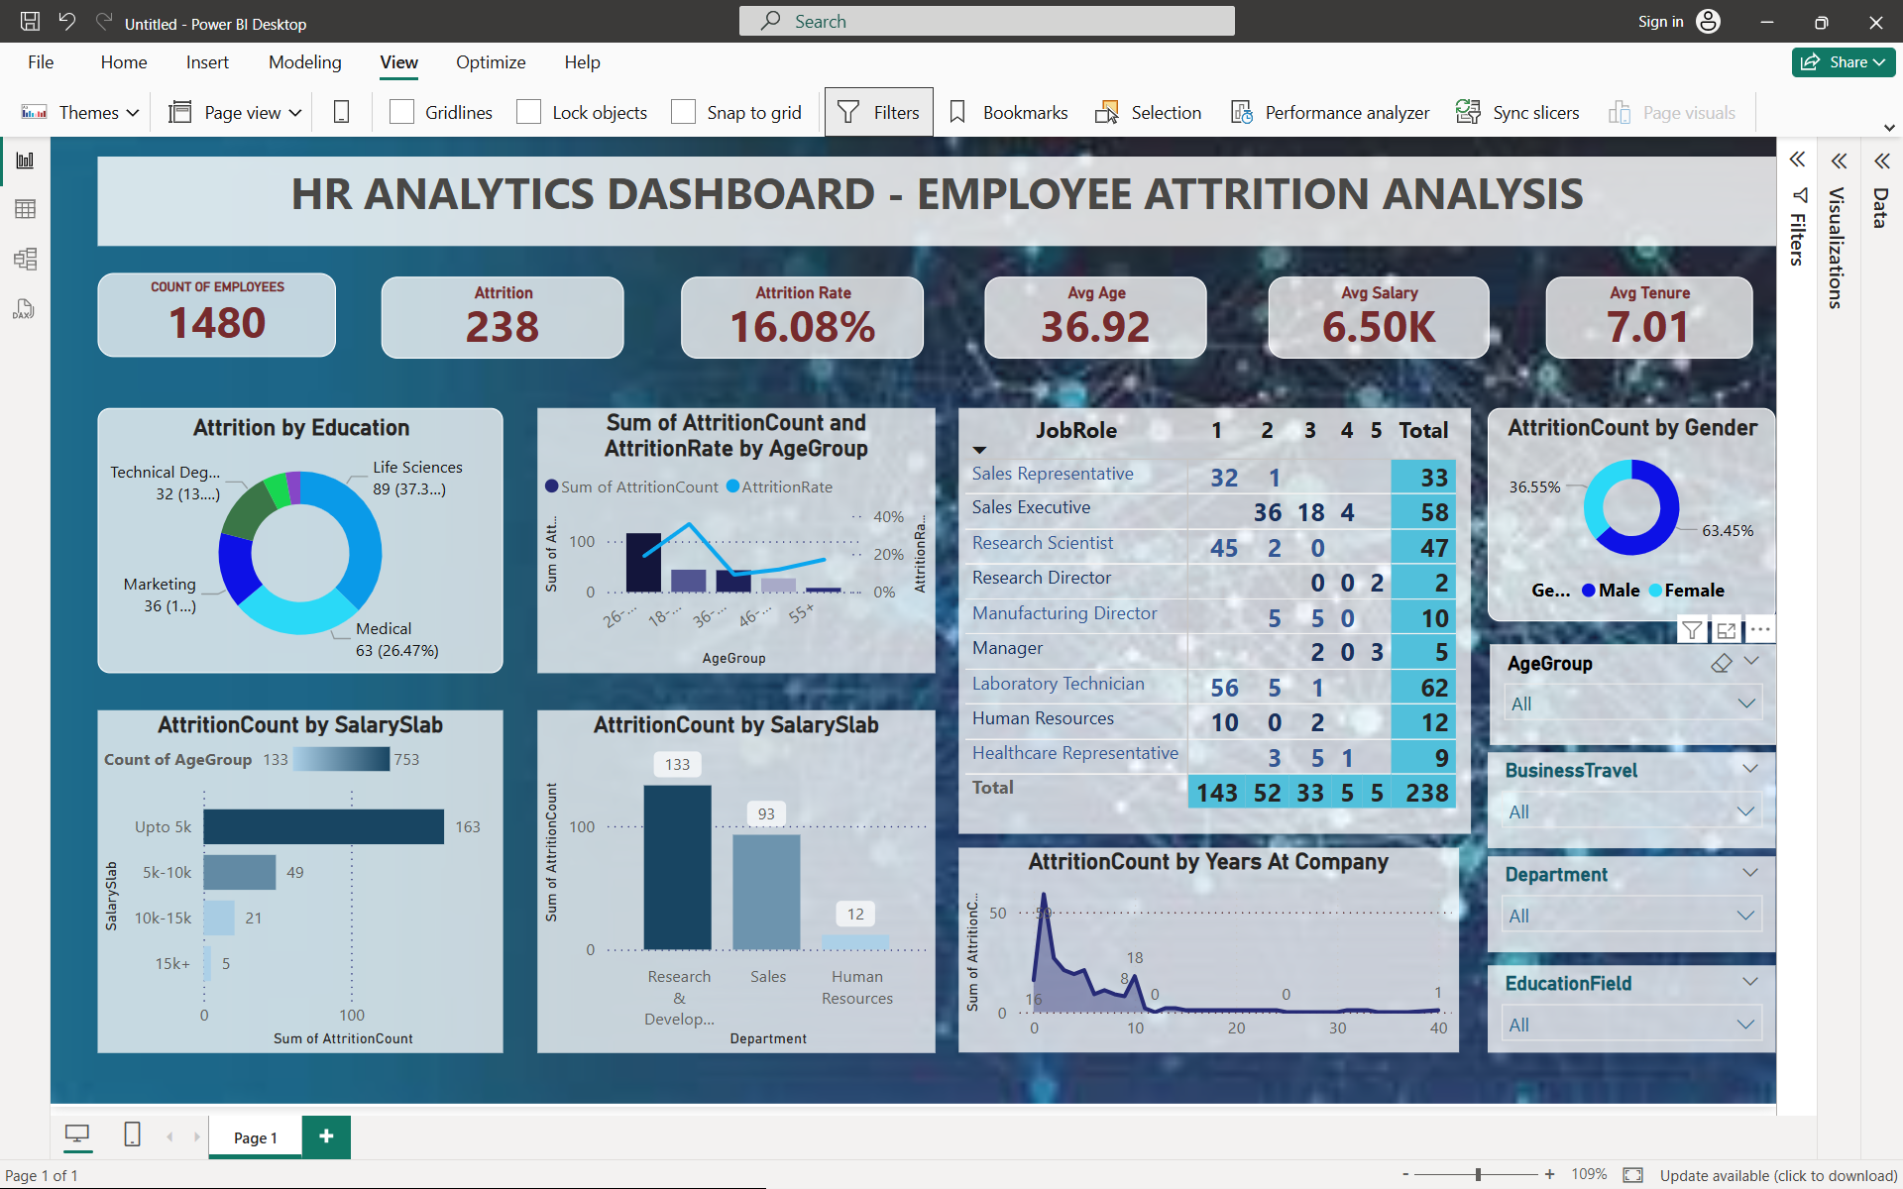
Integrating Predictive Attrition Model into HR Dashboard
Empower HR with actionable insights to proactively address potential employee attrition.
Real-Time Monitoring: Track and monitor employees predicted at risk of attrition.
Prioritization: Focus on high-risk individuals for retention interventions.
Trends & Analysis: Visualize attrition patterns over time to inform strategic HR decisions.

Slide 6
Integrating Predictive Attrition Model into HR Dashboard (Explained)
🔹 Key Metrics:
👥 Total Employees: 1,480
❌ Attrition Count: 238
📉 Attrition Rate: 16.08%
🎂 Average Age: 36.92 years
💰 Average Salary: $6.50K
🏢 Average Tenure: 7.01 years
Attrition Overview: For the most important features, in orange is identified where the attrition rate are higher than the overall attrition rate of the company .

